Slide 1
COT5615: Math for Intelligent Systems I
Anand Rangarajan
Lecture 28

Slide 2
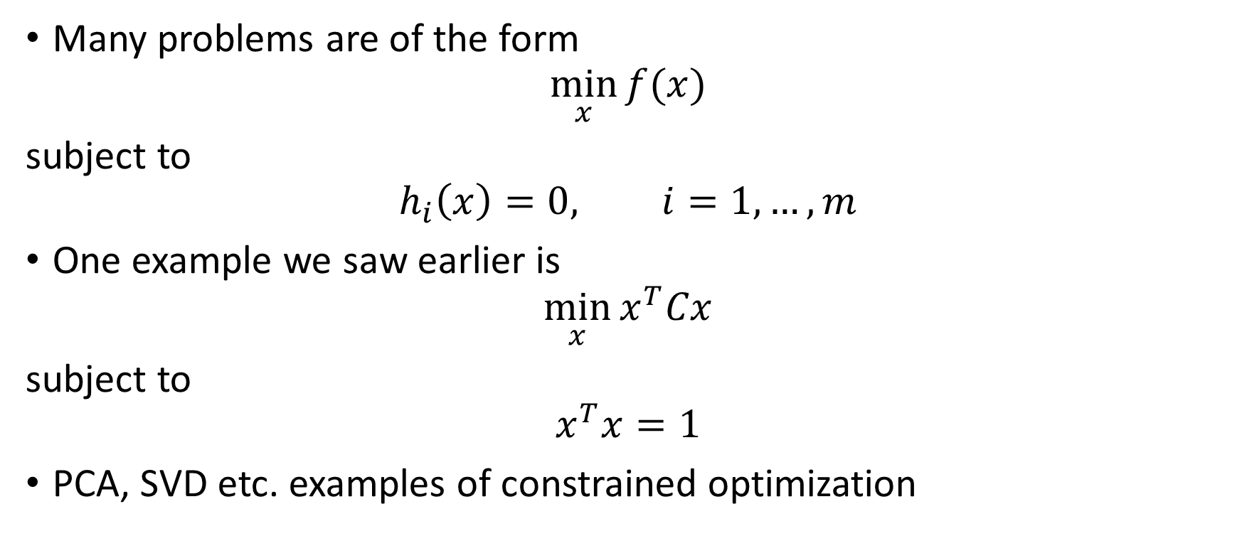
Constrained Optimization
Many problems are of the form
$$\min_{x}{f(x)}$$
subject to
$$h_{i}\left(x\right)=0, i=1,…,m$$
One example we saw earlier is
$$\min_{x}{x^{T}Cx}$$
subject to
$$x^{T}x=1$$
PCA, SVD etc. examples of constrained optimization

Slide 3
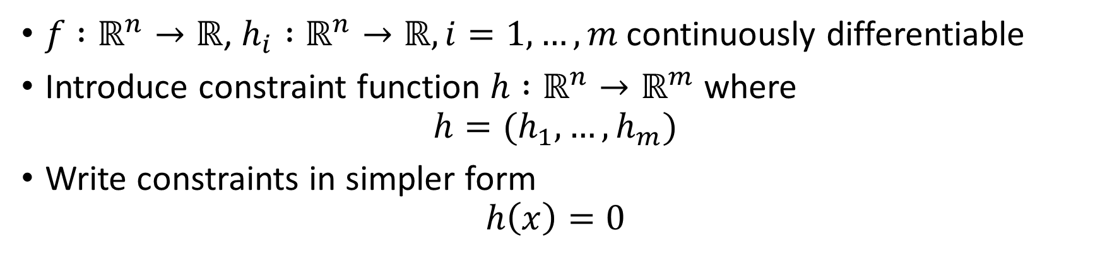
Notation
$f :ℝ^{n}→ℝ$, $h_{i} :ℝ^{n}→ℝ, i=1,…,m$ continuously differentiable
Introduce constraint function $h :ℝ^{n}→ℝ^{m}$ where
$$h=(h_{1},…, h_{m})$$
Write constraints in simpler form
$$h\left(x\right)=0$$

Slide 4





Single equality constraint
$$∇f(x)$$
$$x_{A}$$
$$∇f+λ∇h_{1}=0$$
$$∇h_{1}(x)$$
$$h_{1}\left(x\right)=0$$

Slide 5
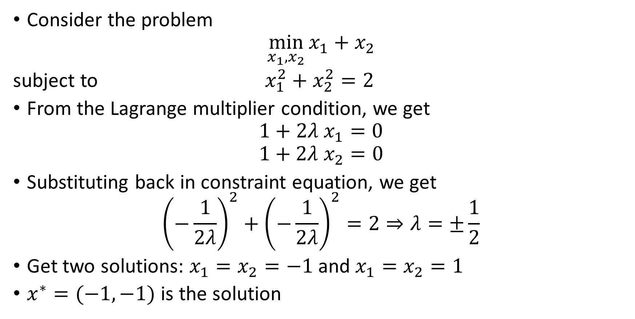
An example
Consider the problem
$$\min_{x_{1},x_{2}}{x_{1}+x_{2}}$$
subject to $x_{1}^{2}+x_{2}^{2}=2$
From the Lagrange multiplier condition, we get
$$1+2λ x_{1}=0$$
$$1+2λ x_{2}=0$$
Substituting back in constraint equation, we get
$${\left(−\frac{1}{2λ}\right)}^{2}+{\left(−\frac{1}{2λ}\right)}^{2}=2⇒λ=±\frac{1}{2}$$
Get two solutions: $x_{1}=x_{2}=−1$ and $x_{1}=x_{2}=1$
$x^{∗}=(−1,−1)$ is the solution

Slide 6






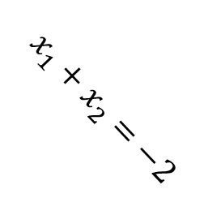


$$x_{2}$$
$$\sqrt{2}$$
$$h\left(x\right)=0$$
$$x_{1}+x_{2}=−2$$
$$\sqrt{2}$$
$$x_{1}$$
$$∇f\left(x^{∗}\right)=(1,1)$$
$$x^{∗}=(−1,−1)$$
$$∇h\left(x^{∗}\right)=(−2,−2)$$

Slide 7
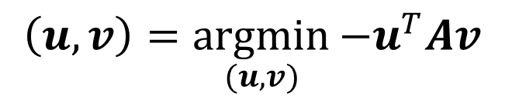
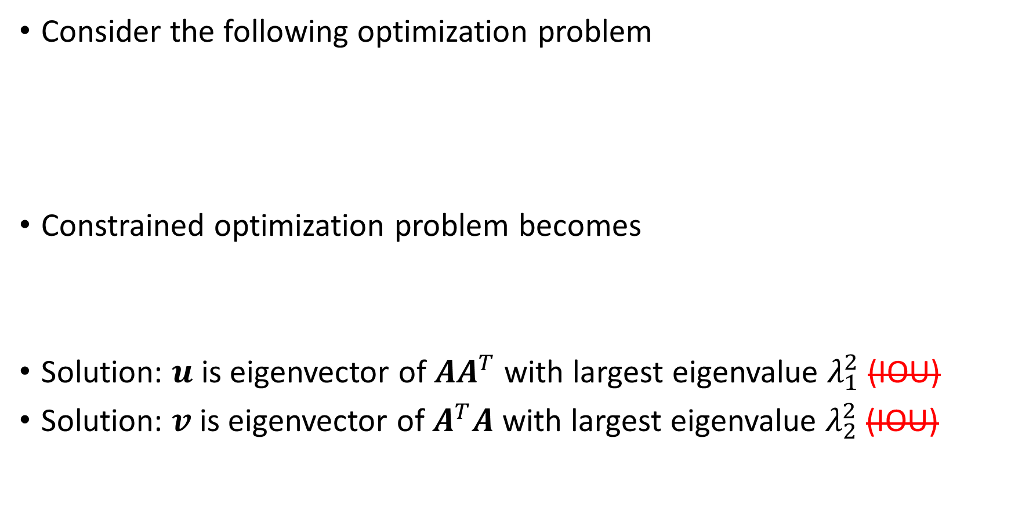
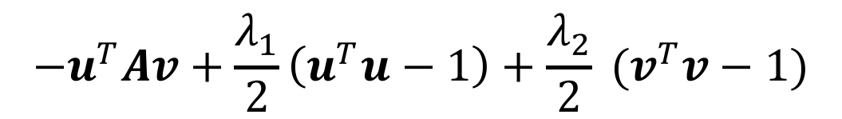

The SVD from a maximization principle
Consider the following optimization problem
Constrained optimization problem becomes
Solution: $u$ is eigenvector of $AA^{T}$ with largest eigenvalue $λ_{1}^{2}$ (IOU)
Solution: $v$ is eigenvector of $A^{T}A$ with largest eigenvalue $λ_{2}^{2}$ (IOU)
$$\left(u,v\right)=\underset{(u,v)}{argmin}{−u^{T}Av}$$
subject to $u^{T}u=1$ and $v^{T}v=1$
$$−u^{T}Av+\frac{λ_{1}}{2}\left(u^{T}u−1\right)+\frac{λ_{2}}{2} (v^{T}v−1)$$
$${σ_{1}=u}^{T}Av=v^{T}A^{T}Av/λ_{1}=u^{T}AA^{T}u/λ_{2}$$

Slide 8
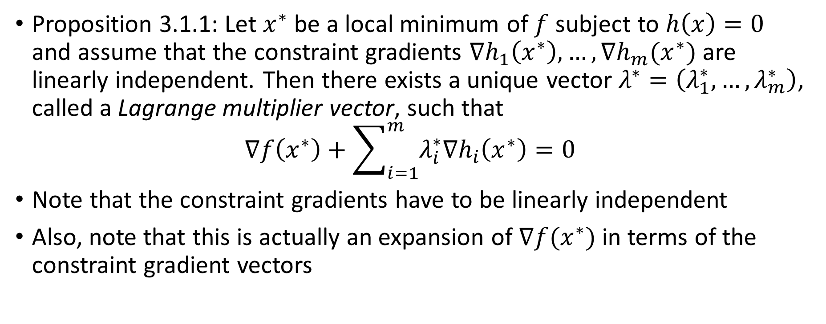
Lagrange Multiplier Theorem
Proposition 3.1.1: Let $x^{∗}$ be a local minimum of $f$ subject to $h\left(x\right)=0$ and assume that the constraint gradients $∇h_{1}\left(x^{∗}\right),…,∇h_{m}(x^{∗})$ are linearly independent. Then there exists a unique vector $λ^{∗}=\left(λ_{1}^{∗},…,λ_{m}^{∗}\right)$, called a Lagrange multiplier vector, such that
$$∇f\left(x^{∗}\right)+\sum_{i=1}^{m}{λ_{i}^{∗}∇h_{i}\left(x^{∗}\right)=0}$$
Note that the constraint gradients have to be linearly independent
Also, note that this is actually an expansion of $∇f(x^{∗})$ in terms of the constraint gradient vectors

Slide 9
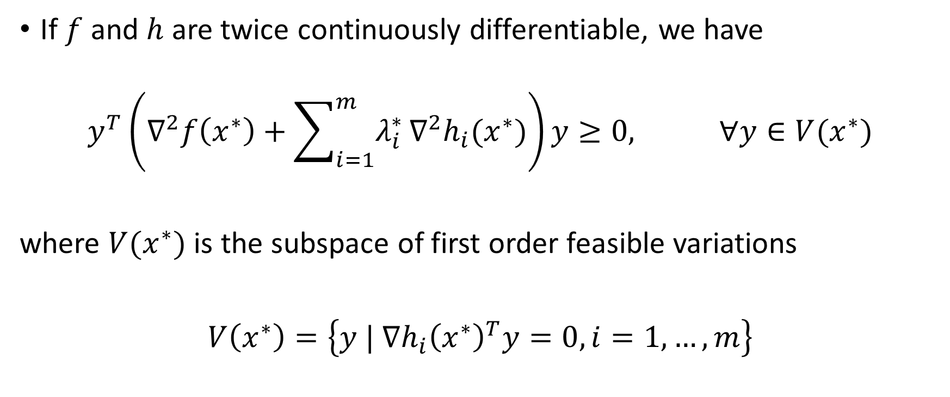
Lagrange Multiplier Theorem (contd.)
If $f$ and $h$ are twice continuously differentiable, we have
$$y^{T}\left(∇^{2}f\left(x^{∗}\right)+\sum_{i=1}^{m}{λ_{i}^{∗}}∇^{2}h_{i}(x^{∗})\right)y≥0, ∀y∈V(x^{∗})$$
where $V(x^{∗})$ is the subspace of first order feasible variations
$V\left(x^{∗}\right)=\left\{y | ∇h_{i}{\left(x^{∗}\right)}^{T}y=0, i=1,…,m\right\}$

Slide 10
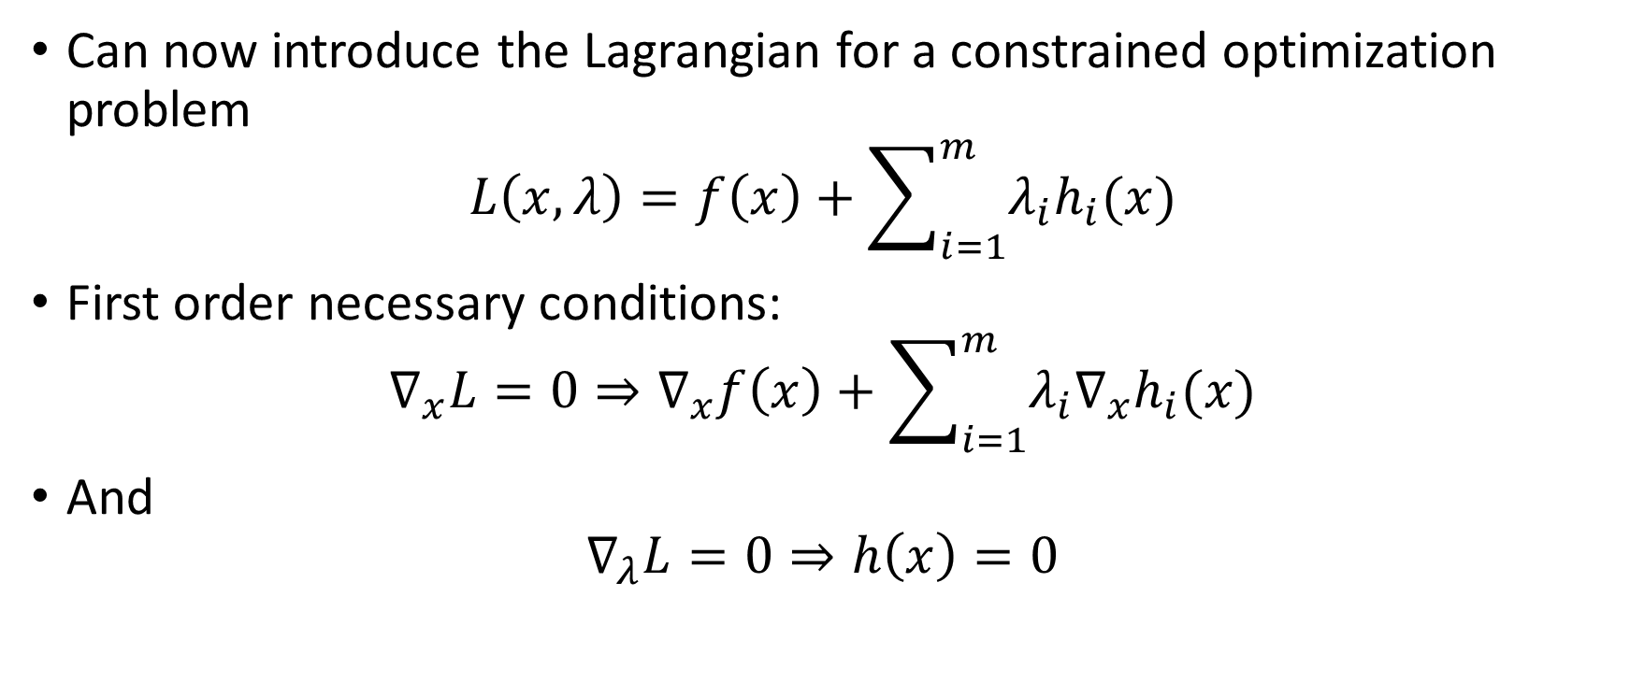
The Lagrangian
Can now introduce the Lagrangian for a constrained optimization problem
$$L\left(x,λ\right)=f\left(x\right)+\sum_{i=1}^{m}{λ_{i}h_{i}(x)}$$
First order necessary conditions:
$$∇_{x}L=0⇒∇_{x}f\left(x\right)+\sum_{i=1}^{m}{λ_{i}{∇_{x}h}_{i}(x)}$$
And
$$∇_{λ}L=0⇒h\left(x\right)=0$$

